Slide 1
Disk Defragmentation
System Tools & Utilities

Slide 2
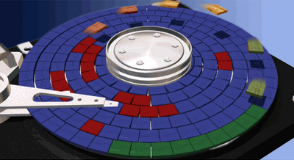
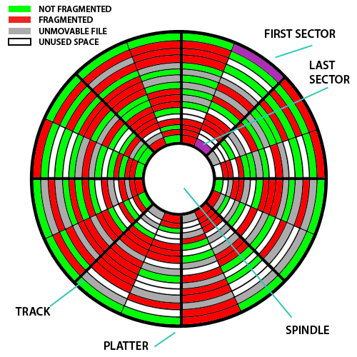
Fragmented Disk
Files are written to a disk in chunks called “sectors”
A large file may be composed of many sectors
The sectors used for a file do not need to be next to each other
However, it is more efficient if the file sectors are next to each other.
Over time, file sectors can get scattered all over a disk.
The file contents is not affected by this condition.
However, it becomes very slow to read and write these files.
The disk has to spend a lot of time moving its magnetic sensors and looking for different sectors.
This condition is called a “Fragmented Disk”

Slide 3
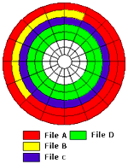
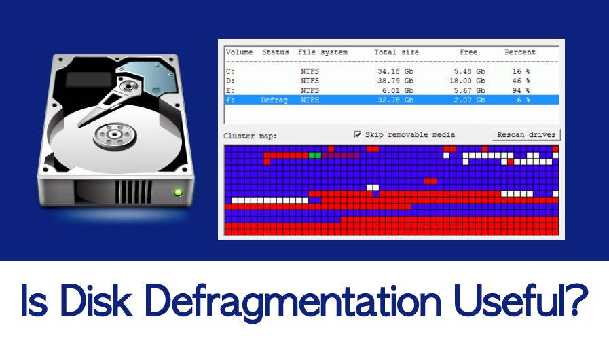
Defragmented Disk
The Defragmentation Tool restores a disk to a more efficient operating condition.
It reorganizes the disk so that all sectors in a file are next to each other.
It does this by cutting and pasting file sectors to move things around.
This process may take several hours for a large disk drive.
The Defragmentation Tool is found in in the System Utilities folder on Windows Systems
It should be used:
When your PC starts to run slowly
On a periodic basis for routine maintenance

Slide 4

File Shredding – Bonus Topic
When you delete a file, is it really deleted?
(Even when you empty the trash can)

Slide 5
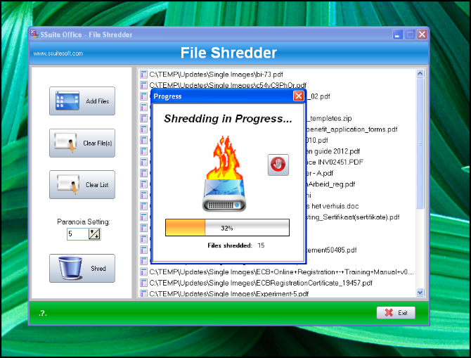
File Shredding – (to Rally Delete)
When a file is deleted:
Only the link to the first sector is deleted.
The sectors and file data is still stored as it was before the file was “deleted”.
The file sectors are only changed if / when they are needed for new files.
This makes file deletion on a Windows PC very fast and easy.
This means that “deleted” files:
Can be easily restored / recovered with the proper software tools.
Can be easily recovered by Police / Criminals
What you should do:
Install a 3rd party “File Shredder” application to make sure that data is totally erased / written over with a meaningless pattern.
Physically destroy your disk drives when you recycle your home PC.

